Slide 1
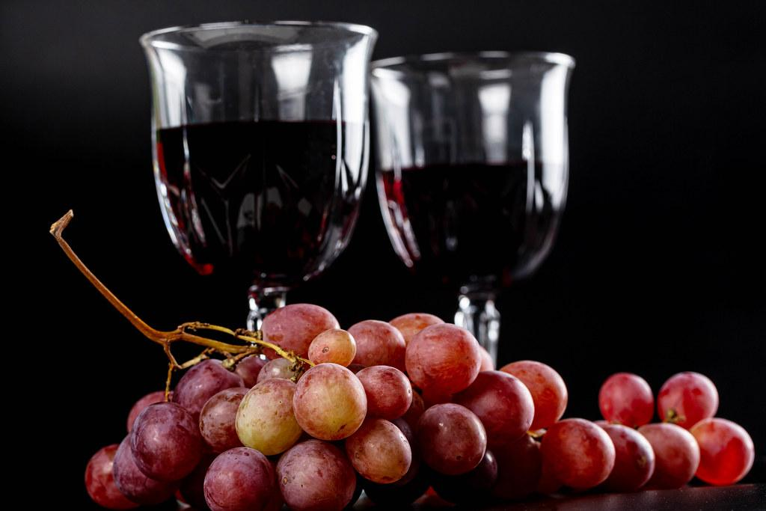
Wine Ratings
Predicting Wine Quality

Slide 2
The Problem

Slide 3
Finding the Wine Rating
The stakeholder for this issue would be a wine manufacturer. The goal of my machine learning model is to discover how different variables affect the rating that a wine receives.

Slide 4
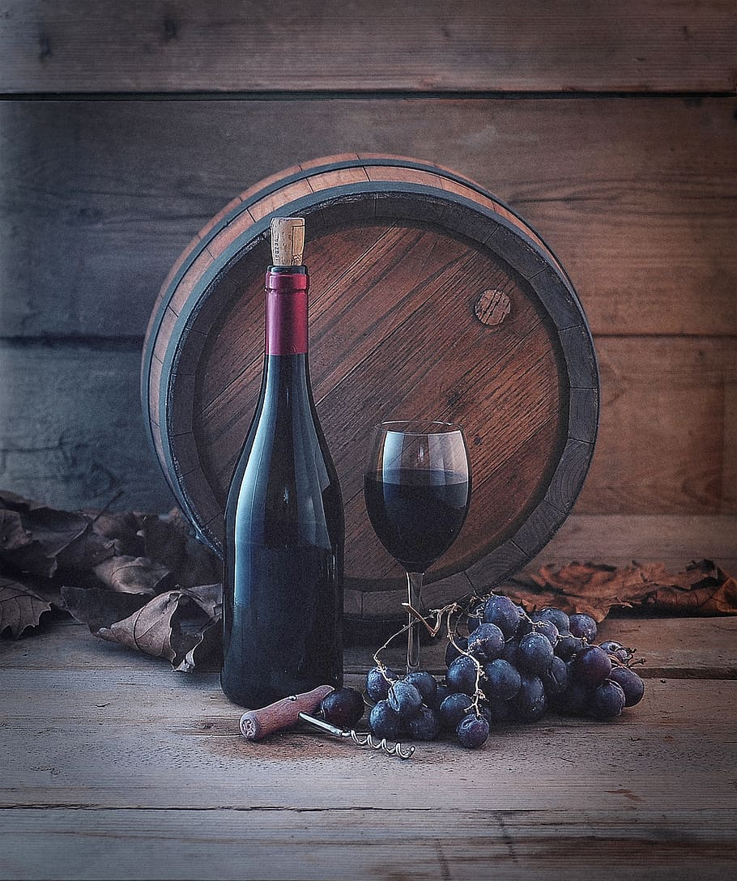
The Data

Slide 5
Explaining the Data
I have used the Spanish Wine Quality Dataset from Kaggle.
https://www.kaggle.com/datasets/fedesoriano/spanish-wine-quality-dataset
There are over 7000 different wines, and 10 features to describe them.

Slide 6
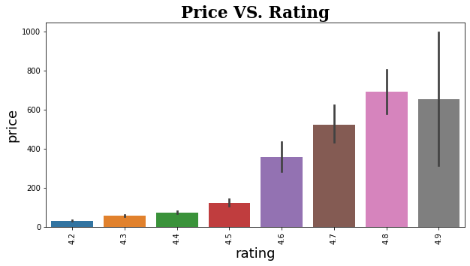
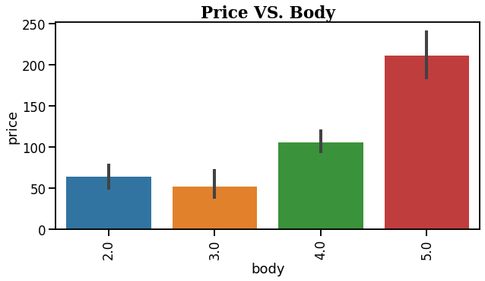
Visualizing the Data
According to the first graph, the price of the wine seems to have the greatest effect on the rating.
The second graph show the higher priced wine, seems to have a higher body number, implying that a higher body means a better quality of wine.

Slide 7
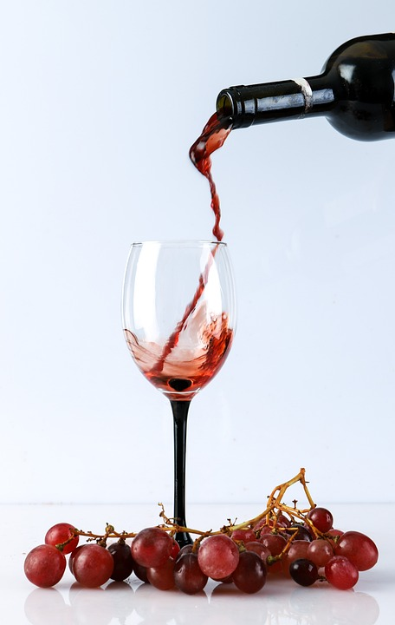
The Model

Slide 8
Explaining the Model
I created a multiclass classification model to determine the rating of the wine from 4.0 to 5.0. The accuracy of the model was 49% at best, which is very poor. While processing the data for the model, I dropped thousands of duplicate rows. This caused the model to be trained poorly. There are a high number of false negatives and false positives.

Slide 9

Verdict
This dataset has a large amount of duplicate values and does not have enough unique data to properly train the model. I would not recommend this model, as it needs a better dataset for training.

